Slide 1
Monday 22nd June
How many words can you make from these letters? All the letters together spell the name of a creature… p s p h o
m i u a c
p

Slide 2
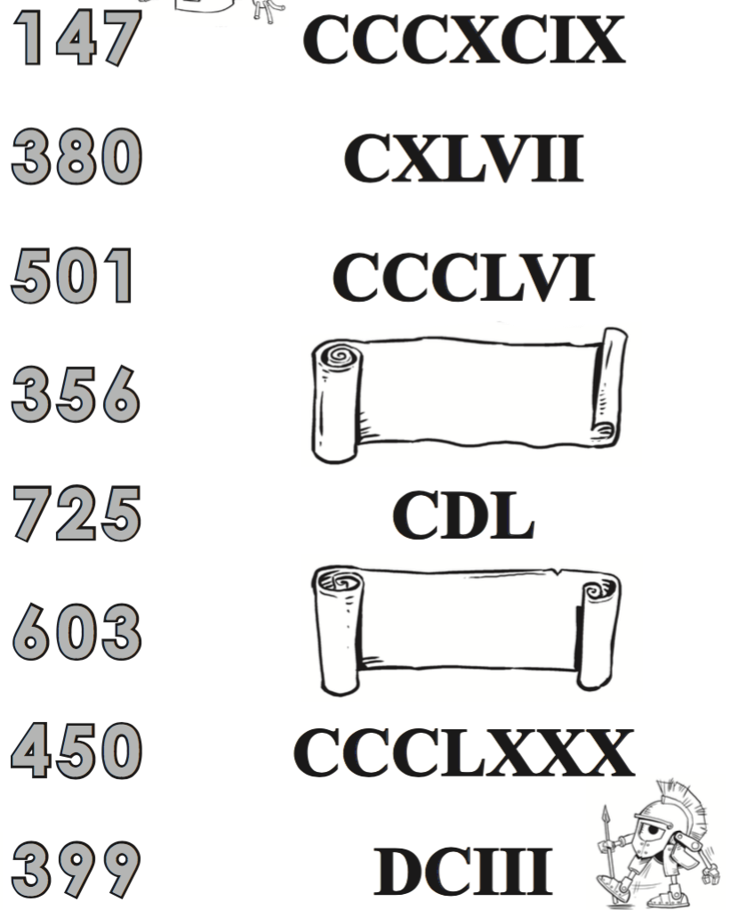
RECAP… Roman
Numerals
Match the
equivalent
numbers:

Slide 3
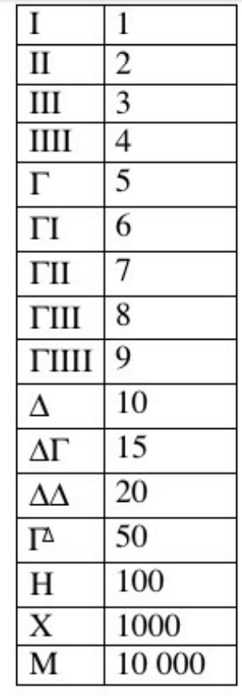

Slide 4
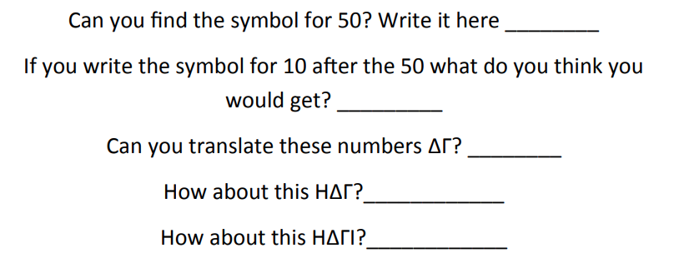

Slide 5
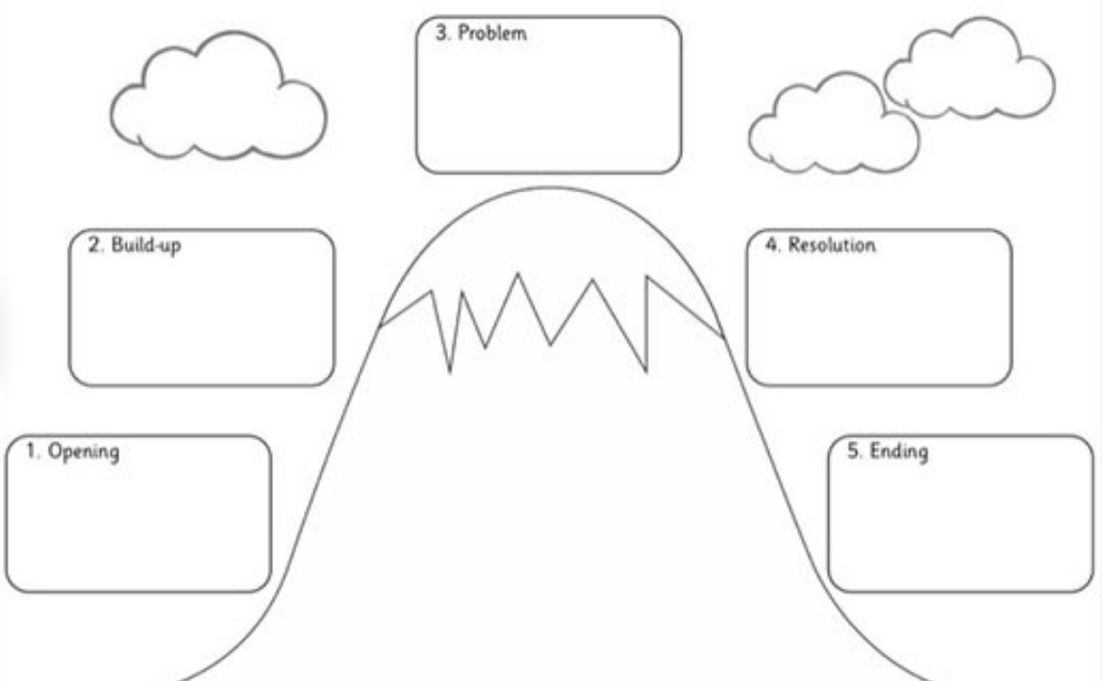
Include a conversation (speech)
There must be a valid
reason for the talking – it must
advance the action!
The monster!
Where do you find it?
How did you know it’s there?
Description of monster.
Feelings.
Who wants them to fight the monster? Why?
Journey to find it.
Dilemmas along the way.
Any help from the Gods?
Fight scene.
Each action has a reaction.
Short and punchy sentences. Tension.
Introduce character
Character description
Setting – where do they live?
Who with?
How did they become a hero?
Have they just got back from another quest?
Reactions of others.
Do they go back home?
Lived happily ever after?
Learnt a lesson?

Slide 6
Tuesday 23rd June
23.6.20
Complete your plan.
Make sure you have planned to use speech!
Look at your battle scene from last week. Using a purple pen, mark the following:
Powerful verbs (from the learning wall) = pv
Adverbs (from the learning wall) = ad
Paragraphs = //
Short and punchy sentences = s+p
Fronted adverbials that show speed of attack = fa
We will talk about any you aren’t sure about just before Maths and add any to the learning wall.
Quiet reading.

Slide 8
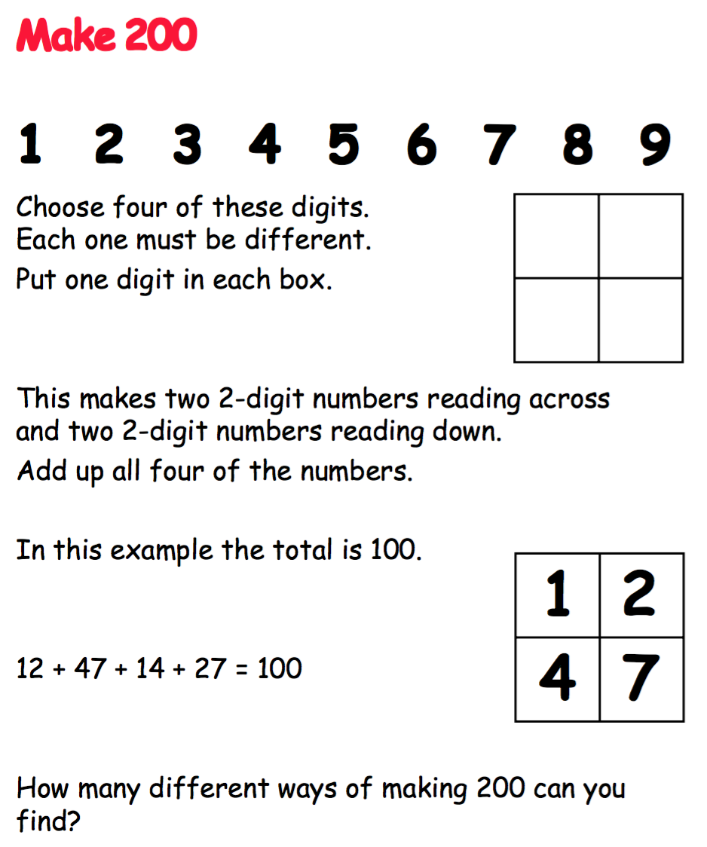

Slide 9
Punctuate the speech accurately:
Hercules shouted to Pegasus, “Help!”
”You will need the shield to look at Medusa’s reflection,” Hermes explained.
Odysseus asked, “Will you free my men?”
“The problem is,” Circe mused, ”they ate like pigs.”

Slide 10
Tuesday 23rd June
To be successful: (Opening and Build up)
Include speech. (There must be a valid reason for the talking – it must advance the action!)
Punctuate speech accurately (including commas).
Write consistently in the past tense.
Write in paragraphs.
Include at least 4 expanded noun phrases.
Include one simile.

Slide 11
Hercules stared ashamedly at the ground. On their weekly visit to the marketplace with his father, Hercules had caused another incident. His father looked at him with a mixture of disappointment and love. Hercules loved helping his father with the market run, but struggled to keep his phenomenal strength under control. All the market traders were shouting irritably. Hercules’ father turned the cart around and began the long, tiresome journey home to the farm.
“Hercules… I have something important I need to tell you,” his father said reluctantly. ”Eighteen years ago, your mother and I, were walking through the gorge when we heard a baby crying. It was you. You had a medallion around your neck. It displayed the symbol of Mount Olympus.” Hercules’ father paused, waiting for his son to take in the news. “I… I’m not sure I understand,” Hercules replied.
“Nor do I and your mother fully,” his dad explained. ”But we thought it was about time you found the answers for yourself.”
With that, Hercules left the next morning, looking for an explanation.

Slide 12
Wednesday 24th June
24.6.20
Check your opening and build up from yesterday includes all these things.
To be successful:
Include speech. (There must be a valid reason for the talking – it must advance the action!)
Punctuate speech accurately (including commas).
Write consistently in the past tense.
Write in paragraphs.
Include at least 4 expanded noun phrases.
Include one simile.

Slide 13
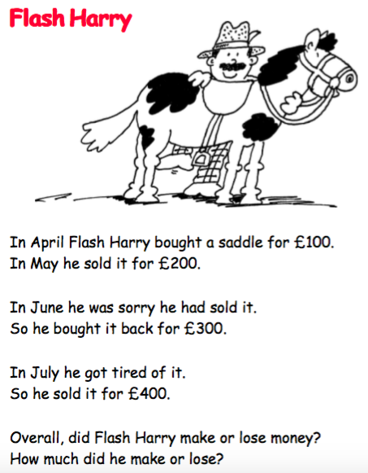
£300
£200
£100
£0
- £100
- £200
- £300

Slide 14
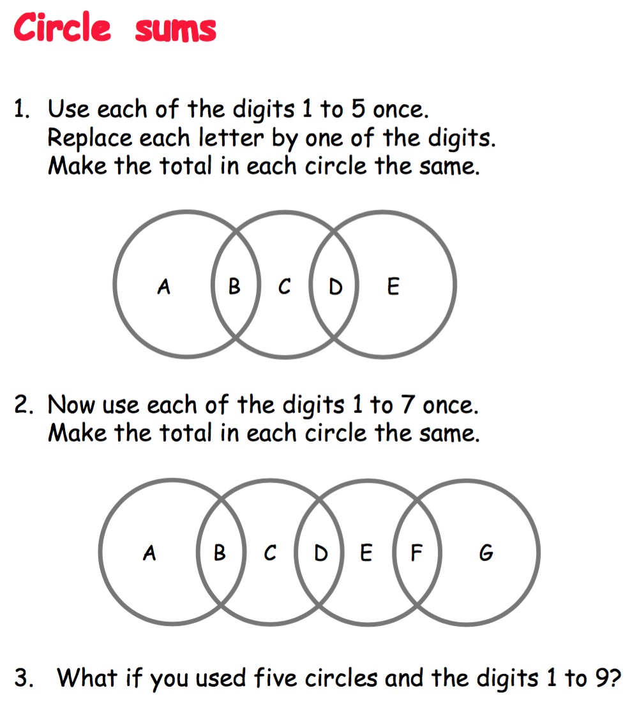

Slide 15
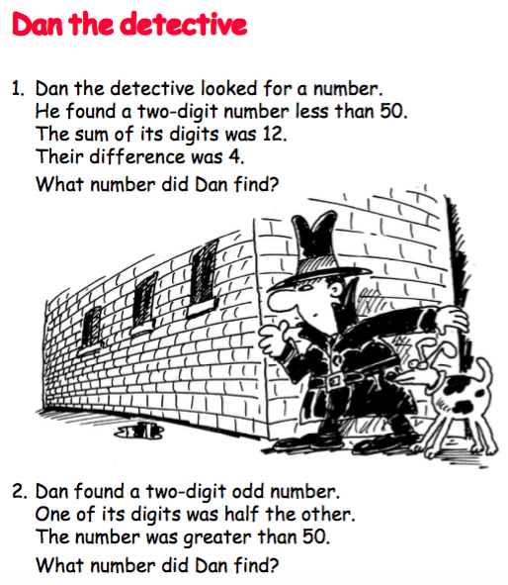

Slide 16
To be successful: (Battle scene – dilemma)
Write consistently in the past tense.
Write in paragraphs.
Include at least 7 powerful battle adjectives.
Include at least 5 battle adverbs.
Include at least 3 fronted adverbials which show speed.
Include two ‘sets’ of 3 or 4 short and punchy sentences.
Tail slashing. Heads thrashing. Growling viciously. Cerberus took three mighty steps towards Hercules. Hercules repeatedly stepped backwards, away from the advancing beast. He had to make time to think things through. To make a plan.
Without warning, one of the hound-like heads jabbed towards Hercules. He swerved left, narrowly avoiding the attack. Cerberus appeared to be growing increasingly angry.

Slide 17
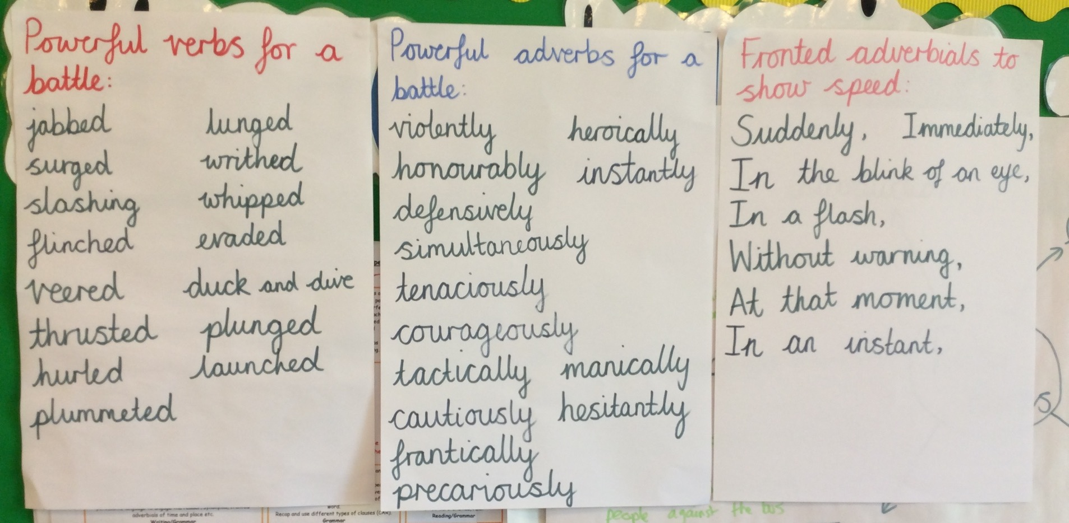

Slide 18
During the times referred to as ‘Ancient Greece’ the country was divided into parts called ‘city states’. Each state had its own different rules and way of life.
Use these websites to find out about two of the key city states: Athens and Sparta.
http://www.primaryhomeworkhelp.co.uk/greece/sparta
http://www.primaryhomeworkhelp.co.uk/greece/athens
www.dkfindout.com/uk/history/ancient-greece/ click on ‘Athens’ or ‘Sparta’
www.ducksters.com/history/ancient_greece/sparta
www.ducksters.com/history/ancient_greek_athens
greece.mrdonn.org/athens
http://www.ancientgreece.co.uk/sparta/home_set
historykids.net/history/ancient-sparta-facts-information
kids.kiddle.co/Classical_Athens

Slide 19
Life in Athens | Life in Sparta

